Slide 1
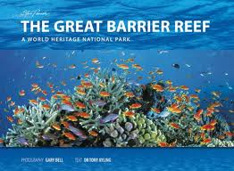
By: Samantha Gallen
Emily Passion
Marla Pelep
Sharon Venessa Kiluwe

Slide 2
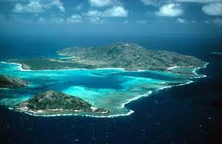
Quick Facts:
world’s largest coral reef system
composed of over 2,900 individual reefs
includes 900 islands stretching over 2,600km
the reef is located off the coast of Queen land in the Northeast Australia
the reef can be seen from outer space
Also the world’s biggest single structure made by living organisms

Slide 3
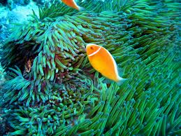
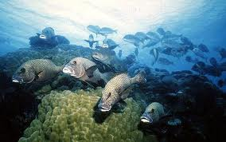
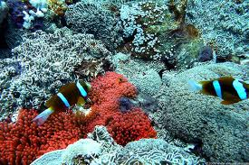
More facts about the reef…
a large part of the reef is protected by the Great Reef Marine park
has long been known to and used be the *Aboriginal Australian and* Torres Strait Islanders
important part of local group’s cultures and spirituality
popular destination for the tourists* Whitsunday Islands and* Cairns regions
the great barrier reef supports a diversity of life, including many *vulnerable or *endangered species, some of which maybe *endemic to the reef system.

Slide 4
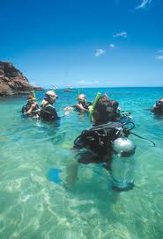
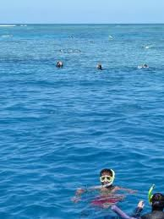
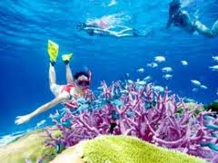
Best times to explore the Reef
The weather is tropical fairly(sunny)
the summer temperatures range from 73 to 91 degrees
the winter months range from upper 50s to mid 70s
the rainy season occurs from November to May

Slide 5
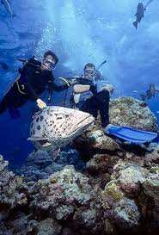
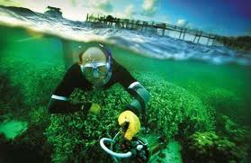
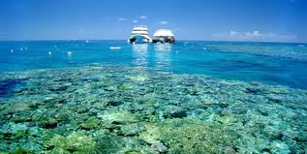
Best ways to experience the natural wonder
A spectacular experience is to have an up close and personnel encounter through either a snorkeling or scuba diving expedition.
“ Live Boards” which are floating guest facilities provide an opportunity for visitors to experience the reef up close for extended periods
also selecting from a variety of boat or cruise tours that include single day trips
an helicopter tour is also an excellent way to get above the Natural Wonder and witness the size and expanse of the Marine Park

Slide 6
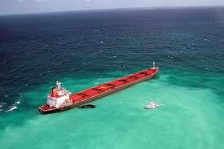
Environmental Threats to the
Great Barrier Reef(-)
sea temperature/ bleaching of the reef
climate changing
fishing like overfishing of keystone species
shipping accidents like oil spills, habitat destruction anchoring and nets
tropical cyclones

Slide 7
CITATION
http://sevennaturalwonders.org/

Slide 8
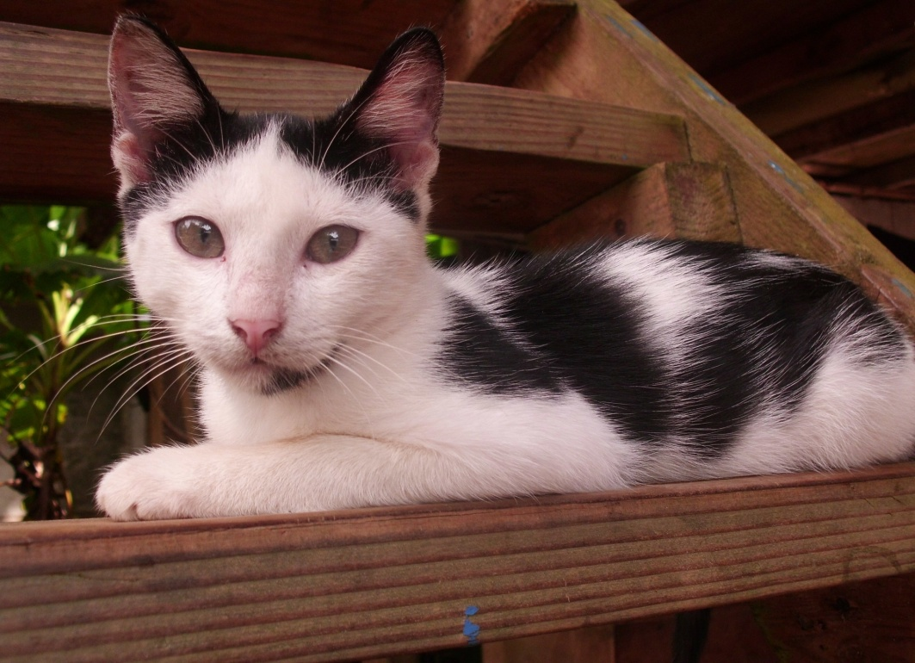
Any ?????S
Thank you all!!

